Slide 1
To Email or Not to Email:
How Parent-School and Parent-Child Communication Changes in Upper School
Thursday, May 1st, 2014
This presentation will be posted on the Upper School Counseling Service page

Slide 2
"As parents, our need is to be needed. As teenagers, their need is to not need us. This conflict is real; we experience it daily as we help those we love become independent of us."
~Dr. Haim Ginott, author of Between Parent and Teenager (1969),
as quoted in How to Talk to Teens will Listen and Listen so Teens will Talk (Faber and Mazlish, 2005)
Great reads!

Slide 3
COLLEGE IS THE EXPECTATION
PLP academic partners have a variety of teaching philosophies and methods, but every single AP's ultimate end-goal is to prepare their students to be successful in college from day one
Upper school is the LAST STOP before students are in the tougher, less supportive, less forgiving, more expensive college environment
Upper school is an immersion experience -
Culture of academic rigor, high expectations, engagement, tough love...
WITH support, encouragement, nurturing environment

Slide 4
9th Grade: A Year of Great Change
Everything seems new to students: school, peers, relationships, expectations, interests
Relationship dynamics between adolescents and parents begin/continue to change and can seem sudden and/or extreme
Each teen is an individual with a unique personality and special interests
Understanding normal developmental changes in teens can help parents interact with their child more effectively and know when to "step in" versus encouraging their child to manage their own problems

Slide 5
Normal Developmental Changes in Teens
Struggle with a sense of identity
Tendency to return to childish behavior when stressed
Increased and sometimes intense need to feel separate from family and accepted by peers
Rule and limit testing
Realization that parents aren't perfect and have faults
Capacity for abstract thought
Development of ideals/values/selection of role models
Worries about being normal, but a need to be unique and special
Mostly interested in the present, with limited thought of the future (can impede ability to think things through)
Ability to think and argue logically is often well developed at this age - can be stressful for adults at times :)

Slide 6
Communicating with Teens
Our two greatest tools are:
Effective modeling - actions speak much louder than words to teenagers
Effective listening - reading between the lines of what they say to determine how they feel and what they really mean
When your child is upset or stressed, help them to come up with their own solutions:
Take time first to identify their feelings (most important step)
Ask open ended questions
Help them brainstorm all potential solutions
Avoid giving advice

Slide 7
Using Logical and Natural Consequences instead of Unrelated Punishments
Tend to work well with teens because of their ability to think and argue logically
Teens tend to fight unrelated punishments more or view them as revengeful or unfair
Unrelated punishments don't typically teach a lesson or change behavior, which is the ultimate goal

Slide 8
Using Logical and Natural Consequences instead of Unrelated Punishments
Natural consequences are not imposed by a parent but rather parents allow their child to experience them:
ex. If he forgets his homework on the kitchen table, he must do without it for the day and turn it in late tomorrow for reduced or no credit
ex. If she procrastinates on a project,
she turns in what she has completed on the due date

Slide 9
Using Logical and Natural Consequences instead of Unrelated Punishments
Logical consequences are related to the misbehavior, are not judgemental or emotional, are based on respect and promote responsibility:
ex. If she skips homework to attend practice, she must miss next practice to complete all missing assignments. Then help her devise a plan to manage her time better.
ex. If he misuses his PLP-issued computer, he loses the privilege of using it for a time

Slide 10
It is VITAL that adults remain calm when imposing a logical consequence, or else it may come across as revenge to the teen
It is VITAL that whenever a consequence is imposed, the student has the ability and understanding of what they must do to earn the privilege back - otherwise, they have no incentive to change the undesired behavior
ex. teen must make up all missing assignments by Friday at 3pm in order to earn back ability to practice and participate in matches next week
Short-term consequences (i.e. days or a week) often work more effectively than long-term consequences (i.e. month, term, semester) - teens think in the "here and now"

Slide 11
Parental Involvement in Upper School
School-Parent communication is still very important in upper school, even though students are becoming more self-directed and independent
However, the type of involvement changes from more direct to more indirect and "behind-the-scenes"
Parental role changes from the child's "personal manager" to more of a "mentor" and occasional advocate

Slide 12
Parental Involvement in US
Attend curriculum night, athletic events, performing arts events, college planning night, and other school events
Contribute to PLP in ways that are a natural fit for you and your family
Take your teen on college tours beginning freshman year, so they can start to make the connection between what they are doing in school and the end-goal
Ask your child open-ended questions about what’s happening at school each day
What was the most important thing that happened today?
What did you enjoy about today?
What challenges did you have today?
What did you do well today?

Slide 13
Use Home Base as a conversation starter
Agree with your teen on a good time for you and him/her to check it together weekly
Ask open-ended questions about his/her progress:
What did you do well this week?
What can you do better next week?
What are your target grades in each class? Are those the grades you need to get into the colleges you're interested in?
What do you need to do to reach your target grades?
What help might you need along the way?

Slide 14
Try to avoid checking Home Base on your own, as that is often viewed as an invasion of privacy by adolescents, even if warranted. Always try to check it WITH your child.
Freshmen students should check Home Base and Edmodo daily
Parents can check as often as needed for their particular child, with the goal of moving the student toward self-regulation and independence
Good rule of thumb for the majority of parents of freshmen is once/twice weekly for the 1st semester and once weekly for 2nd semester

Slide 15
Parent-AP Communication
How will US APs communicate with me about my child’s grades?
The main source of communication is Home Base
Grades are typically posted on a weekly basis
Report cards - each term is considered a "checkpoint" with the final overall grade occurring in May (the final grade is the only grade that goes on the transcript - colleges will NOT see quarter grades)

Slide 16
Parent-AP Communication
How will US APs communicate with me about my child’s grades?
APs may email parents if there are chronic failing grades, chronic absences/tardies or consistent missing assignments
For this age group, APs do not contact parents every time an assignment is missed or a low grade is earned, since students are expected and being actively taught to self-monitor and problem-solve issues - experiencing a grade drop often helps students to self-correct

Slide 17
Parent-AP Communication
How can I contact an AP if I have a concern?
Email is the best way!
When approaching an AP about a situation, keep in mind that there are usually more details that both the AP and parents are unaware of - effective communication serves to get everyone on the same page
APs and parents are on the same side and are partners in helping your child succeed
Open communication and open minds are vital to this process

Slide 18
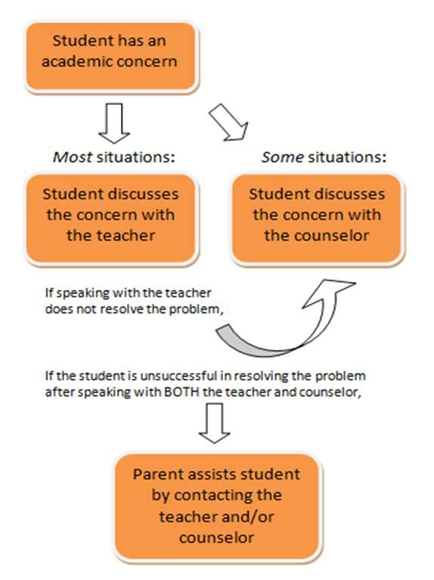
Student-Directed Problem-Solving
Counselors are trained "troubleshooters!"
Developmentally appropriate for 9th-12th graders
Appropriate in most situations
Help your child to find the proper channel for assistance
Parents should become involved after the student has made a thorough attempt to problem solve on their own first

Slide 19
Importance of Student-Directed Problem-Solving
Gain confidence in themselves to handle personal struggles. Empowering!
Important practice for handling larger problems in the future
Can apply these learned skills to social life, college decisions, family situations, etc.
Promotes independence and self-sustainability
These are required skills/characteristics for success in college, so they must practice them now
It's also important for them to know their parents are available to help if they ever have a problem they don't know how to handle on their own!

Slide 20
Examples...
Student Initiates Problem-Solving | Parent Initiates Problem-Solving
Forgot homework Has a question about the assignment or homework Does not understand the material Fails a test Needs tutoring Difficulty getting along with the teacher Was absent, needs make-up work Difficulty navigating Edmodo Distracted in class Experiencing test anxiety Experiencing a conflict with a classmate or peer Poor organizational skills Needs help with study skills or test-taking strategies | Possible undiagnosed learning disability, medical issue or psychiatric issue that impedes learning Student borderline/failing in multiple classes Attendance issues Severe discipline issue(s) Inappropriate conduct by an AP Student is struggling with a chronic issue in which he/she has made multiple attempts to troubleshoot on his/her own unsuccessfully

Slide 21
Case Study
Toward the end of the second term, your son John tells you he "doesn't get math" and "just isn't a math person." His grades are lower than you think he is capable of earning. Here are some open-ended questions you ask him to help point him in the right direction:
When did the problem start?
What topics or units in your math class do you not understand?
What have you done so far to try and learn the material?
Who have you talked to about this problem?
Who can you talk to about this problem?
Where can you go at PLP to get extra help with this problem?

Slide 22
Wrapping up...
Remain involved, even though the type of involvement changes
Help your child develop their problem-solving and conflict resolution skills by encouraging them to attempt to solve problems on their own first
When your child is faced with a problem, determine at what point you should step in to assist
Always feel free to contact an AP with questions or concerns

Slide 23
Thank you for working with PLP
as partners in your child's education!
Questions? Please contact Whitney Triplett, Upper School Counselor, at wtriplett@pinelakeprep.org

