Slide 1
The Freshman Shock:
Your New Academic Responsibilities
in Upper School

Slide 2
What have you heard about Upper School?
See
"Advice from
Past Students"
PowerPoint

Slide 3
Quotes from Current Students...
"The classes have a lot more material so you really have to be organized and keep up."
"Grades you earn now will be seen by colleges."
"APs put more responsibility on you and make you do a lot more but it is easier if you make better relationships with them."
"APs offer help if you need it but they don't try to hold your hand. You are on your own, but they are willing to help."

Slide 4
COLLEGE-PREP RIGOR
"rigor" means...
Pushing yourself b e y o n d what is easy
Pushing yourself beyond what is comfortable
To be scared, but still try
To keep trying again and again in different ways until you get it right

Slide 5
COLLEGE-PREP RIGOR
PLP offers only ONE diploma type and it is the most academically rigorous of the nine NC diplomas that are available at most traditional high schools
ALL courses in the PLP Upper School are college prep courses
Standard-level college prep
Honors-level college prep
Advanced Placement ("AP") college-level courses

Slide 6
COLLEGE-PREP RIGOR
It is expected that ALL students will struggle with the material at some point while in the Upper School - this is ok and is the nature of a rigorous course of study.
The level of rigor at PLP prepares students to be successful in college no matter which institution they choose to attend.
When you struggle, you learn coping skills that you can apply to similar situations in the future. If you do not struggle now, you WILL in college - a more costly environment with less support and resources.
Colleges will only see the final grade in each course. They will NOT see term grades.

Slide 7
As Upper School APs,
our #1 goal is to make sure
you are fully prepared
to be successful at ANY university of your choosing!

Slide 8
Basics to know....
Colleges see all final grades for courses taken in Upper School
1 course passed = 1 high school credit
All courses required for graduation must be passed with a D or higher. Students must retake any required course that they earn an F in.
Failing courses may jeopardize your ability to graduate on time
Taking honors courses only helps your GPA if you earn high grades in them.
If you demonstrate that you are a strong student, you may take college courses as a junior and senior for both high school and college credit

Slide 9
PLP Graduation
Requirements
ENGLISH (4 credits required)
MATH (4 credits required)
SCIENCE (3 credits required)
SOCIAL STUDIES (4 credits required)
FINE ARTS (4 courses, 1 per year)
SPANISH (2 credits required for graduation, but Spanish must be taken all 4 years)
PE (4 credits required)
ETHICS OF TECHNOLOGY and PUBLIC SPEAKING (1 credit required, 0.5 each)
Service Learning (40 hours per school year, 160 total)
Pride Project (passing grade on paper, product and presentation)

Slide 10
Skills You Need to be Successful in Upper School:
Completing and turning in all assignments on time
Well-organized and consistently using some form of a daily planner or agenda
Managing your time effectively by prioritizing and balancing school, family, and extracurricular life
Comfortable seeking out adult help when needed
Using effective communication skills to resolve conflicts with others (peers and adults)

Slide 11
Academics:
What to Expect...

Slide 12
ENGLISH SUMMER READING ASSIGNMENTS
Mandatory - comprises a large percentage of the Term 1 grade
Students will be tested on the material and will engage in projects and activities for which the reading is a prerequisite
No make-up opportunities or extensions will be available to students who do not complete the summer reading assignments
Summer 2013 Standard level: Tuesdays with Morrie by Mitch Albom; Enders Game by Orson Scott Card
Summer 2013 Honors level: Narrative of the Life of Frederick Douglass by Frederick Douglass; Tuesdays with Morrie by Mitch Albom; Enders Game by Orson Scott Card LINK

Slide 13
MATH (9th grade vs. 8th grade)
Grading scale is more challenging:
Algebra I (9th gr)
Tests/quizzes worth more
Test corrections are not offered
Students expected to be more responsible for knowing what their assignments are and when they have quizzes and tests
Standard Math | Honors Math
Tests 55% Quizzes 35% HW 10% | Tests 50% Quizzes 30% HW 20%

Slide 14
MATH (9th grade vs. 8th grade)
Geometry (9th gr)
Regardless of how students did in Algebra, Geometry is completely different - not a typical computational math class, but a class in logic. This can be a difficult transition for many.
Students "learn their way" over the course of the year. Term 1 grades often reflect a difficult transition and balance out as the year progresses. Colleges will only see the final grade!
Basic algebra skills are reinforced
Algebra II/Trig (9th gr)
Advanced organizational skills required
Homework every night to reinforce learning, but does not count for a large part of the grade

Slide 15
ENGLISH (9th grade vs. 8th grade)
In 9th grade, reading is mostly done at home and class time is spent in discussion, interpretation and analysis of the text.
More in-depth studies and discussions
A significant increase in homework and the difficulty level of assignments
Students must read at home in order to pass the unit/term
1st term is usually a big adjustment period

Slide 16
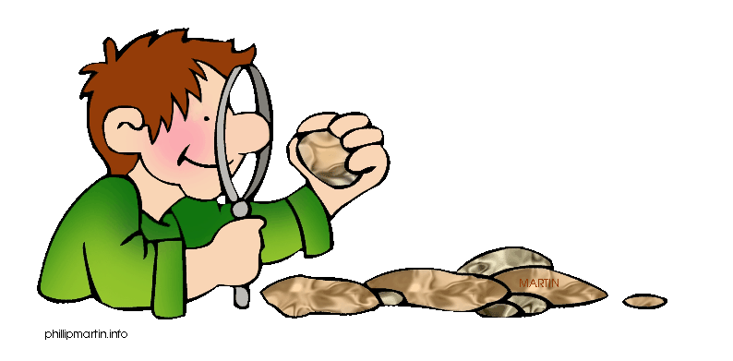
SCIENCE (9th grade vs. 8th grade)
Biology
Earth Science

Slide 17
SOCIAL STUDIES (9th grd vs. 8th grd)
World History (majority of students)
8th grade has more projects with class time given to complete them, whereas 9th grade has more in-class presentations, with less class time given to complete them
Tend to use their computers more in the upper school
9th grade has shorter writing prompts and weekly assignments (i.e. current event articles)
Study guides are graded
Late policy = honors students can turn in work one day late for 90%; Standard-level students have two days to submit late work for a 90%
Civics/Economics (only for students interested in and ready for AP World History sophomore year)
Students held to higher standards in preparation for AP World History (not only academic standards, but a higher level of maturity, self-accountability and attention to detail are necessary for success in this class freshman year)

Slide 18
SPANISH (9th grade vs. 8th grade)
Spanish I
Content is identical to the 8th grade version, since it is the same course as it's 8th grade counterpart, intended for high school credit
Spanish II
Functions will expand to include the progressive tenses, telling time, giving orders, discussing feelings, making comparisons and referring to habitual actions in the past
Cultural awareness is expanded with more specific study of the Spanish-speaking world.
Students will be required to engage in more challenging discussions in Spanish and English as they use their critical-thinking skills to restate and assess both written texts and recorded passages.

Slide 19
FINE ARTS (9th grade vs. 8th grade)
Art 1
Projects become more open-ended. Guidelines are given, but students must come up with their own unique subjects and ideas.
Students complete a much larger painting unit
Grade determined by growth in the content area, consistent work habits/self-efficacy, effective use of class time
Chorus
Extra performance during the year
Great deal of emphasis is placed on the students' individual responsibility to uphold the integrity of the ensemble, the music, and the sound that is made

Slide 20
FINE ARTS (9th grade vs. 8th grade)
Band
Music literature is more challenging
Students learn more scales
Theater
More academically driven
Students are expected to perform in front of their peers in monologues and duet scenes
Begin writing monologues and short scenes

Slide 21
Homework and Studying
in Upper School
"Study Skills and Myths"

Slide 22
HOMEWORK
As students age, the amount of responsibility increases
PLP students have reported experiencing a large jump in the amount and difficulty level of homework from 8th to 9th grade
The average student at PLP can expect about 2 hours of homework, on average, per night in the upper school
This workload will likely be heavier if you are enrolled in all honors courses (NOTE: it is not advised that students take all honors courses unless they are willing to put in the necessary time and work - for many students this often means a substantial sacrifice of cutting back on athletics, clubs, jobs, or other extracurricular activities in order to maintain A's and B's)

Slide 23
HOMEWORK
Homework may or may not be graded, but do it anyway - it will help you learn the material and your test grades will show it.
Busy work is not assigned - every assignment facilitates learning and is expected to be completed, whether or not it is graded.
Homework and studying should occur EVERY night. Some nights may have a lighter workload than other nights, but it is rare for a student to not have homework in any class on a given night.

Slide 24
STUDYING
Homework and studying are two different things:
Homework is an actual assignment that a student is expected to complete, usually by a certain deadline.
Studying is the purposeful review of material with the intent of reinforcing material that has already been learned. It is often not graded nor assigned.
DAILY studying is expected in upper school. Just studying when a test or quiz is coming up may or may not cut it.
It is common for students not to have had to study in middle school or to have had to study minimally, but most students cannot maintain the grades they earned in middle school without studying in upper school

Slide 25
STUDYING
Lack of effective studying is usually a main reason grades drop during freshman year. While some study skills are taught in class, learning to study is largely a self-directed activity that students must learn through trial-and-error.
Examples of INEFFECTIVE studying:
Re-reading studying guides, looking over notes
Examples of EFFECTIVE studying:
Re-writing or re-stating study guide material in your own words, then quizzing yourself or a friend
Teaching the material to someone else (real or imaginary)

Slide 26
STRATEGIES for HW and Study Time
Set up a daily homework plan/schedule, write it down and post in a central location such as the fridge.
When will you do HW? Where? What materials do you need? How long should you spend on HW? How can you eliminate distractions?
Take frequent, short breaks (5 min or less) for every 20 minutes of work
Monitor your own computer use - don't open up anything that is not related to school work. It is nearly impossible to concentrate and stay focused if you have multiple windows or tabs open.

Slide 27
A Good Study Spot Should...
Always be easily accessible and available. If your study place is frequently occupied by others, then find different study place.
Protect you from frequent interruptions. If you are constantly interrupted, you won’t be studying effectively.
Be free from distractions (i.e. phone, TV, FB, Twitter, Instagram, Tumblr, email, loud music or music for which you know the lyrics (white noise or soft background music may be fine), crowded areas, and other loud noises. Eliminate anything that distracts you. TIP: study in a different room from your phone.
Have all the supplies you need, including pens/pencils, paper, highlighters, a calculator, or anything else the subject requires. If you are constantly getting up to search for supplies, it will decrease the effectiveness of your study time.

Slide 28
A Good Study Spot Should...
Include a comfortable chair. Find a chair that you can sit in comfortably for long periods of time. Avoid studying on your bed. Because your brain equates sleep with your bed, you may unconsciously be tempted to drift off while studying.
Have a comfortable temperature. If your study place is too hot, cold, breezy, or stuffy it can make it difficult to study.
Have adequate lighting. You need enough light to help you clearly see without straining your eyes. Poor lighting or lighting that is too bright (direct sunlight shining on your textbook) can cause discomfort and headaches.

Slide 29
5 Studying Myths
MYTH #1: Looking over your notes is considered effective studying
FACT: A popular quote that tends to ring relatively true states "we learn a little of what we read, a little more of what we read and hear, even more of what we do and the majority of what we teach someone." If you're one of those students who just looks over their notes, it's unlikely that you're studying effectively enough to earn the grade you really want on a test. Of course, there are always exceptions and risks that sometimes pay off, but why gamble when you can always score the grade you want? Think about the quote above...what can you do to study more effectively?

Slide 30
5 Studying Myths
MYTH #2: "I do better when I cram the night before the test."
FACT: While the information may be fresh in your mind for the test, helping you to earn a better grade than if you hadn't studied at all, cramming is a distant second to studying consistently over several weeks or days. Research has consistently shown that repeated exposure to the material over lengths of time helps us to learn the material more completely. When we cram, we may learn for the moment but not for the long-term - the info often leaves our brain as quickly as it was crammed in. You never know when you'll need to know something in the future. This matters even for material that you think you'll never need or see again. The process of learning makes us smarter.

Slide 31
5 Studying Myths
MYTH #3: "Taking breaks while studying makes me lose focus."
FACT: Our brains cannot focus for more than 15-20 minutes at a time. Some of us can get refocused more easily than others, but everyone needs to take short breaks while studying (5 minutes or less). If you are easily distracted, try studying in a different room from your phone and computer and leave them there the entire time you are studying. During your break, do not use these devices if it will make you lose focus or take a longer break than needed. Instead, try stretching, jumping jacks to get your blood flowing, getting a snack, walking around outside or deep breathing. If we try to force our brains to study when we are unfocused, our study time will likely be a waste of time. Figure out the best way for you to get refocused. Check out these ideas for focus and concentration: http://hackmystudy.com/how_to_focus_and_concentrate.html

Slide 32
5 Studying Myths
MYTH #4: "Listening to music helps me focus while studying."
FACT: Ok, this myth may be partly true. If it's too uncomfortable for you to study in complete silence, it's ok to listen to soft music. However, listening to music you are familiar with or listening to music with lyrics can actually distract you, even if you don't realize it. That's because our brains are unconsciously torn between studying and recalling the melody or lyrics to the song that's playing. If you need music to listen to while studying, it's best to choose music with a calm, unfamiliar melody that has no lyrics (i.e. classical music, instrumental "spa-like" melodies or sounds of nature like ocean waves or birds chirping). Check out the top 10 study tips of all time at www.hackmystudy.com/leos_top_ten_study_tips.html.

Slide 33
5 Studying Myths
MYTH #5: Energy drinks improve your ability to study
FACT: High caffeine intake has been shown to reduce blood flow/oxygen to the brain by an average of 35%, significantly impairing memory and cognition. Additionally, caffeine has actually been shown to hinder your short-term recall, meaning it could hurt your ability to remember even well-learned facts. Lastly, caffeine is a diuretic (increasing your need to urinate), resulting in dehydration. This is important because studies have shown that even a 2% dehydration impairs concentration and causes higher stress levels. What does all this mean? While energy drinks give you short bursts of energy, the benefit gained is minimal and may even do more harm than good when you are studying. And getting an extra few hours of sleep often does more to improve your alertness and focus than any energy drink could. Find out how to END procrastination by visiting http://hackmystudy.com/how_to_end_procrastination.html.

Slide 34
Handout: How to Plan a Homework Schedule

Slide 35
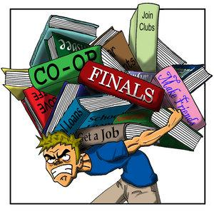
TIME MANAGEMENT

Slide 36
What fills up your time???

Slide 37
Choosing Extracurriculars Wisely
Secret #1: Colleges don't care which extracurricular activities you choose.
Admissions officers are looking to build a well-rounded and diverse freshman class, so they want students with a variety of interests and abilities.
They want to see that you love something and stick with it for the long-term.

Slide 38
Choosing Extracurriculars Wisely
Secret #2: Colleges prefer depth to breadth.
As you get farther along in your high school years, your number of activities should go down, not up.
Younger students need to try out different kinds of activities to figure out what they like. By junior year, you should have a good idea of what you enjoy, so you should start cutting back or eliminating those you don't enjoy and spending more time in those you enjoy most.
Colleges also want to see students taking on more responsibility and leadership roles in their chosen activities as they get to junior and senior year.

Slide 39
Choosing Extracurriculars Wisely
Secret #3: Colleges want students who are good at balancing their activities and responsibilities.
Colleges look at a variety of factors when determining whether to admit a student: grades, rigor of courses, extracurricular activities, recommendation letters, essays - just to name a few.
It is important to not get so wrapped up in one area of your life that you let another suffer. The balancing act can be tough at times but is essential to success in high school, college, and later in life.

Slide 40
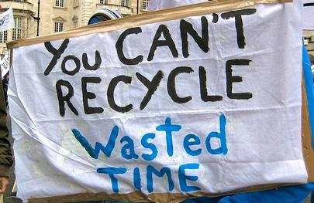
The Key is Balance
Don't overload on one area of your life, whether that is school, sports, friends, relaxation or other areas.
Prioritize what is most important and make time for those activities
Use a planner and write down all activities so you can plan ahead!!
Harness the power of a routine - create an afternoon schedule that works well for you and stick to it

Slide 41
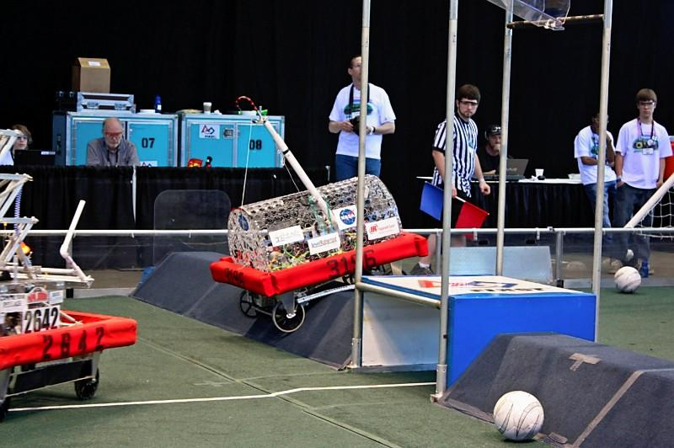
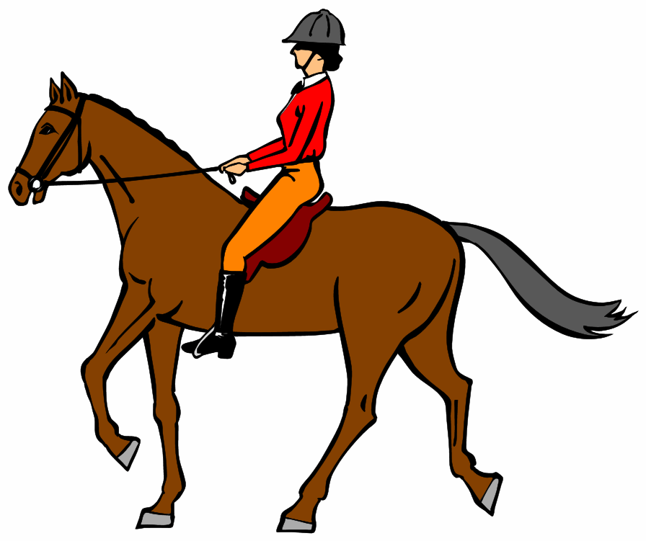
Balancing Extracurricular Activities
Don't get in over your head! Determine how many/which extracurricular activities are possible while still maintaining your target grades.
Time management only gets harder from here on out - if you already struggled in 8th grade, talk to your parents about cutting back or trying new time management strategies.
Choose the RIGHT extracurricular activities for you - things you are passionate about, enjoy and are excited to be involved in. When you like what you are doing, it doesn't seem like work!

Slide 42
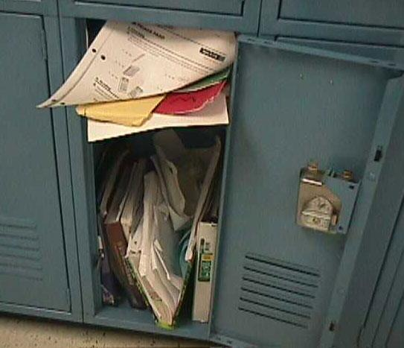
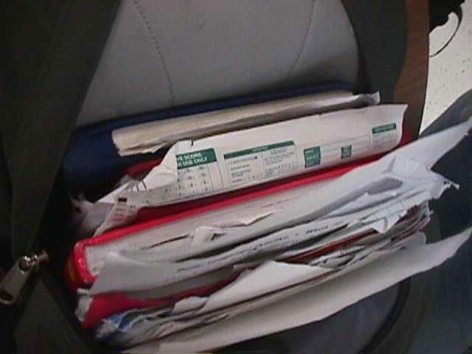
Organization

Slide 43
Effective organizational strategies are one of the best ways to maintain balance!

Slide 44
Planners & Agendas
Post-its - a great way to list out your to-do's. Use with a planner.
Day planner - you can buy daily, weekly or monthly planners. Weekly ones work great for students, so you have plenty of space to write down assignment details and look ahead for the week

Slide 45
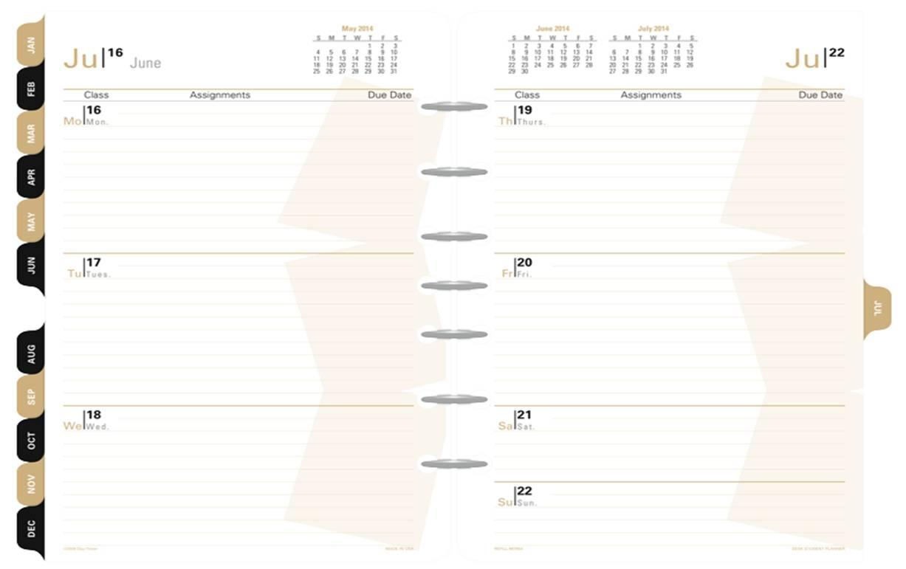
Weekly Planner

Slide 46
Planners & Agendas
Google Docs or Calendar - A great option for PLP students, since they automatically have a PLP google account. This is web-based and can be shared with family and friends. Two-way syncing allows students to access from a computer and/or mobile device.

Slide 47
Planners & Agendas
Spaaze - online virtual corkboard. Pin notes, labels, bookmarks, images, files and videos. Drag and drop to position freely on the board. You can choose to invite others (i.e. classmates, teachers, parents) to read-only or edit their board. Also use it to create digital "poster-board" type presentations for class projects.
MyHomeworkApp - digital student planner. Helps you keep track of homework and assignments, sends reminders, keeps track of class schedules. Sync to any device. Available on AppStore.

Slide 48
Planners & Agendas
Evernote - organizes your notes, files, web clips, webpages, videos and images. Sync to every device you use.
Soshiku - Enter assignments, quickly see overdue and upcoming assignments, organize by course or due date, save notes, attach files, share messages and collaborate with group partners on class projects. Get text messages when due dates are coming up. Easily add assignments from your phone.

Slide 49
Organizing your School Stuff
S. P. A. C. E. METHOD
Sort: Go through each possession and group similar items together (all math stuff together, all English stuff together, etc.)
Purge: Get rid of the outdated, duplicates, excess, undesirable, and irrelevant. Keep all tests and quizzes for the entire school year, so you can use them to study with for midterms and finals.
Assign a home: Decide where each item you are keeping will stay. In a binder? Accordion file? In-tray at home? Drawer? ???
Containerize: Use separate bins, baskets, drawers, and cubbies to keep categories separate and make cleanup a breeze. Label the containers so you can easily find out what's in them.
Equalize: Maintain and update your system to keep up with your changing interests, needs, and priorities.
REPEAT EVERY SUNDAY NIGHT BEFORE YOU BEGIN A NEW WEEK!

Slide 50
How to Get Organized for the Week
On Sunday afternoon or evening, get all your school stuff ready to go - this helps you get in the mindset of "school is tomorrow"
Lay out everything you need to take to school tomorrow
Go through your bookbag and put any loose papers in their right spot.
Briefly flip through your binder, folders or accordion file to see if there is anything due tomorrow that you forgot about
Get your planner out and look at what is coming up for the week - assignments, tests, quizzes, projects, events, activities, games/matches, meetings
Add any to-do's to your planner and make a to-do list for tomorrow - everything you need to accomplish before bedtime Monday

Slide 51
Using EDLINE/PowerSchool to help you organize
You are responsible for checking your own Edline and keeping track of your own assignments. Your parents should be needing to check behind you less and less. (TIP: If you want your parents to back off and give you more freedom, prove to them that you can do it on your own by turning everything in on time and earning high grades)
Many US APs do not post daily assignments to Edline. It is your responsibility to be present to class and pay attention so you can get these assignments. You may not be able to make up these assignments if you are absent.

Slide 52
Managing Conflicts and Issues

Slide 53
What types of conflicts might you encounter in Upper School?
Conflicts with peers - examples?
Conflicts with APs - examples?
Conflicts with family members - examples?
Others???

Slide 54
Resolving Conflicts: DE-ESCALATE!
Your words and actions will either escalate or de-escalate the conflict

Slide 55
To De-Escalate a Conflict...
Avoid texting since it is very difficult to portray tone accurately in a text and your words can easily be misinterpreted. Same goes for email, chatting, posting, etc.
Choose a neutral, private location for the conversation
Aim for one-on-one instead of bringing "back-up" or choosing a location where a lot of people are around
Be mindful of not only your words, but your tone of voice, volume of voice, hand gestures, posture, and facial expressions

Slide 56
Resolving Conflicts with Peers
Generally speaking, it is best to go directly to the person that you are having a conflict with to try to come to a resolution.
The more people who are involved, the more challenging it gets to resolve the conflict quickly and effectively. Involving multiple people takes the control away from you and the conflict becomes more difficult to contain (Think: more rumors, miscommunications, people taking sides).
If necessary, get advice from one or two people that you trust, decide on the best course of action, then act.

Slide 57
Managing School-Related Conflicts - what would you do?
Get into groups of 3 and discuss...
Case #1: You missed school two days last week because you were sick. You now have several zeros in each of your classes.
Case #2: It's one week before the end of the term in English class and your grades are lower than you had hoped.
Case #3: Your assigned seat in math class is beside someone who talks to you constantly even though you rarely start the conversations. On several occasions, your teacher thought you were talking when you really weren't. You feel like the teacher now thinks you're not paying attention and is beginning to not like you.

Slide 58
Problem-Solving in Upper School
If you have an academic concern, you can:
Talk directly with your AP about it
Talk with Mrs. Triplett to brainstorm options
Talk with your parents to get advice or assistance
You can handle many school-related issues yourself. It's an important skill to be able to problem-solve and advocate for yourself. You can always ask for an adult's help if you're not sure what to do.

Slide 59
10 Tips for Talking with Your APs
If you have a problem in a class,
with an assignment, or with an AP,
don't just complain to your friends
– talk with your AP!
Learning to voice your concerns in
an appropriate, respectful manner is an important skill to master.
Here are some tips to help smooth the conversation...

Slide 60
10 Tips for Talking with Your APs...
Make an appointment to meet and talk. This shows the teacher you’re serious and you have an understanding of his or her busy schedule. Be flexible and do NOT be late.
If you know students who feel the way you do, consider having them go with you to talk with the teacher. There’s strength in numbers. If a teacher hears the same thing from four or five people, he or she may be more likely to do something about it.

Slide 61
10 Tips for Talking with Your APs...
Think through what you want to say BEFORE you go into your meeting with the teacher. Write down your questions or concerns. Make a list of items you want to cover.
Choose your words carefully. For example, instead of saying, “I hate doing reports; they are a waste of time,” try, “Is there some other way I could satisfy this requirement? Could I do a video instead?” Never use the word “boring.” It is an overused word and adults tend to tune out when teenagers use it.

Slide 62
10 Tips for Talking with Your APs...
Don’t expect the teacher to do all the work or come up with all the answers. Be prepared to make suggestions, offer solutions or suggest resources. The teacher will appreciate that you took the initiative.
Be diplomatic, tactful and respectful. Teachers have feelings, too. And they’re more likely to be responsive if you remember that the purpose of your meeting is conversation, not confrontation.

Slide 63
10 Tips for Talking with Your APs...
Focus on what you need, instead of what you think the teacher is doing wrong. The more the teacher learns about you, the more he/she will be able to help you. The more defensive the teacher feels, the less he/she will want to help.
Don’t forget to listen. This may seem obvious but many students need to practice this important skill. The purpose of the meeting isn’t just to voice your concern, but to come to a mutual agreement. This requires equal listening from both parties.

Slide 64
10 Tips for Talking with Your APs...
Bring your sense of humor. Not necessarily the joke-telling sense of humor but the kind that lets you laugh at yourself and your own misunderstandings and mistakes.
If the meeting isn’t the success you hoped it would be, get help from another adult, such as a counselor, another teacher or staff member who is likely to support you and advocate for you. Then try again!

Slide 65
Getting Help from the Counselor
Mrs. Triplett is a "trained troubleshooter" - this means her main job is to help students figure out solutions to their problems.
Problems may be related to classes, grades, APs, peers, extracurriculars, home, friends, etc.
Mrs. Triplett is here to help you
manage any issue you may be
facing!

Slide 66
Getting Help from the Counselor
What you say in Mrs. Triplett's office,
stays in Mrs. Triplett's office!
EXCEPT in the following circumstances:
You give her permission to share the info
Harm to self or others
Abuse/neglect
Court/legal order

Slide 67
In groups of 3, discuss: which of the following situations should you problem-solve on your own and which might you need an adult's help?
Forgot homework
Have a question about the assignment or homework
A friend is making dangerous choices
Do not understand the material in a class
Failed a test
Think you may have a learning disability
Need tutoring
Feeling overwhelmed or stressed
Difficulty getting along with the teacher
Were absent, need make-up work
Friend might be suicidal
Difficulty navigating Edline/PowerSchool
Feeling distracted in class
Failing several classes
Experiencing test anxiety
Having a conflict with a classmate or peer
Poor organizational skills
Needs help with study skills or test-taking strategies

Slide 68
College Planning Essentials
Freshman year is the time to start going on college tours if you haven't already! Don't wait until Junior year!
Talk with your parents about your goals and ideas.
Explore colleges you may be interested in and look up the average GPAs for admitted students. See how you "stack up" and find out what you must do to be competitive in the admissions process.
What type of student is the college looking for?
How can you begin becoming that kind of student this year?
Visit the college's website, CFNC.org, ________

Slide 69
College Planning Essentials
Explore your interests, abilities, and values and possible majors and careers
Keirsey Temperament Sorter
Career Outlook Interest Assessment

Slide 70
